Slide 1
Splendor Hotel Group Operational Dashboard
Comprehensive documentation detailing data sources, methodologies, and actionable insights.

Slide 2
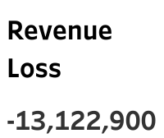
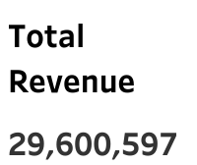
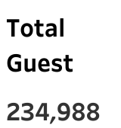
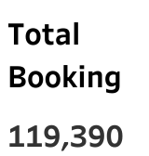

Slide 3
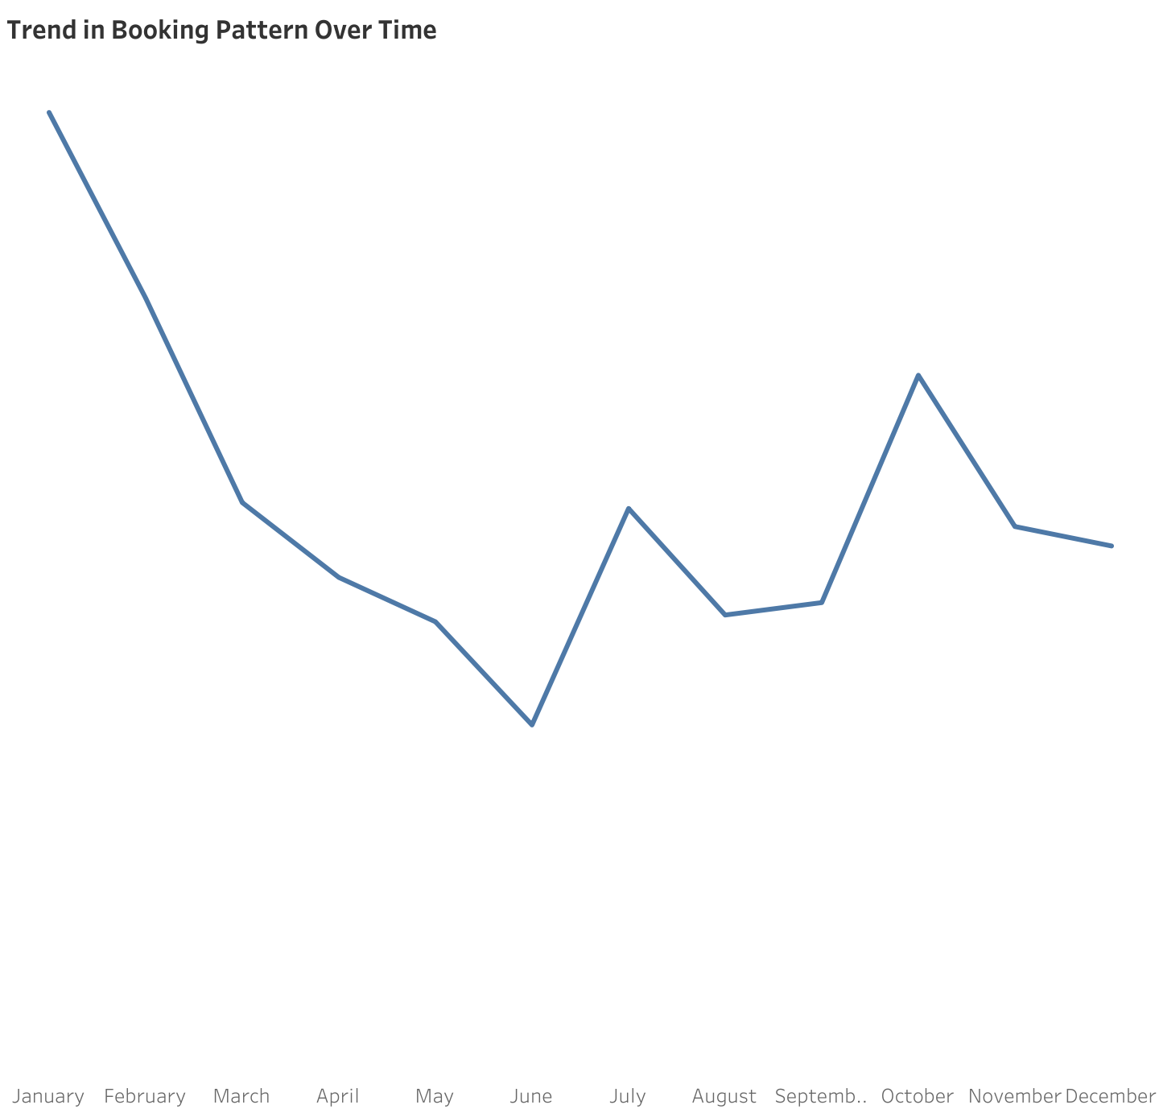
Methodology I have created a line chart to visualize the trend in booking patterns over time.
We aggregated the data by the booking date to count the number of unique bookings (Booking ID) for each period. Insights for Trend in Booking Patterns Over the Year
In January, booking activity peaks with 16,688 unique bookings, indicating high demand likely due to New Year celebrations and winter vacations. In contrast, June records the lowest booking activity with only 6,063 bookings, highlighting a significant drop, possibly due to the summer off-season or other factors. Overall, the booking trend fluctuates throughout the year, reflecting varying demands influenced by seasonal changes, holidays, and local events.
Actionable Recommendations
To address these trends, SHG should focus marketing efforts on the months leading up to June, offering special summer packages and discounts to attract guests. Efficient resource and staff allocation is crucial to handle the peak in January and optimize operations during June's low demand. Collaborating with local events during low booking months can create attractive packages, drawing more visitors. Additionally, implementing loyalty programs and incentives for repeat bookings will help maintain a steady flow of guests year-round.

Slide 4
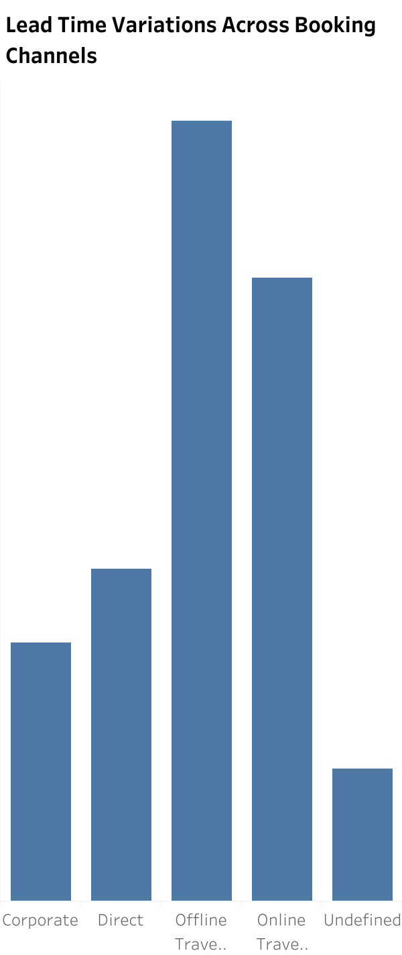
Methodology:
I created a bar chart to show the average lead time for bookings across different distribution channels.
Calculated the average number of days between the booking date and the arrival date for each distribution channel. Insights for Lead Time Variations Across Booking Channels:
Lead times vary significantly across booking channels, with offline travel agents having the longest lead time (135.6 days) and corporate bookings having the shortest (44.91 days). This suggests differing customer behaviors and booking patterns between channels.
Actionable Recommendations:
Tailor Marketing: Customize marketing strategies based on lead time characteristics. Offer early bird promotions for channels with longer lead times and last-minute deals for those with shorter lead times. Adjust inventory and pricing strategies to match lead time trends, optimizing occupancy rates and revenue. Enhance engagement strategies to meet the specific needs of each channel, improving customer satisfaction and loyalty.

Slide 5
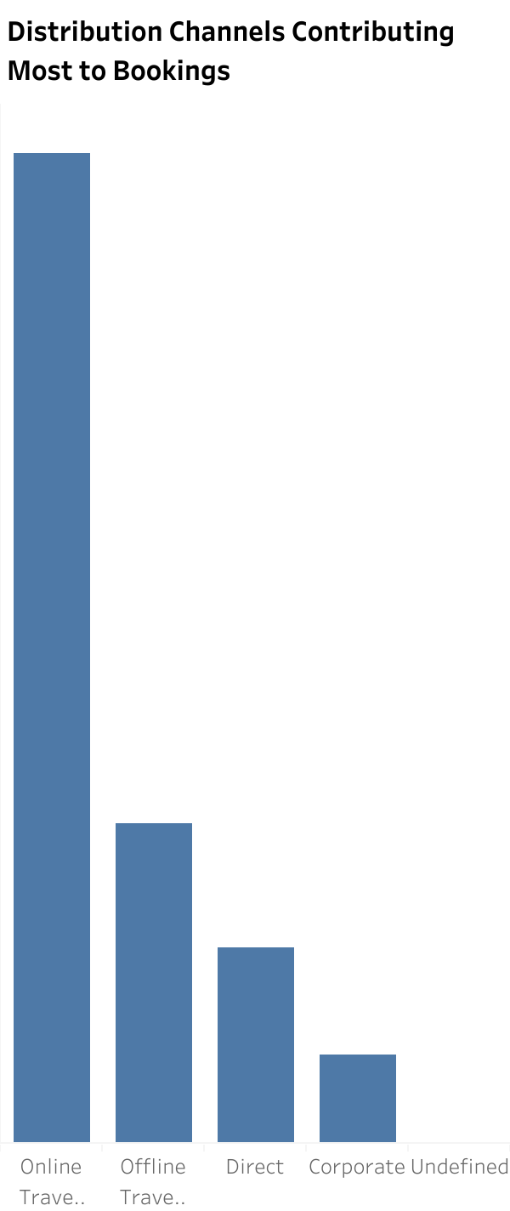
Methodology: Created a bar chart to visualize the contribution of each distribution channel to the total number of bookings. Counted the number of unique bookings (Booking ID) for each distribution channel. Insights for Distribution Channels Contributing Most to Bookings:
Online travel agents drive the highest number of bookings with 74,072 unique booking IDs, while corporate bookings have the lowest count at 6,677, indicating high dependency on the former.
Actionable Recommendations:
To mitigate dependency risks, diversify marketing efforts across multiple channels, strengthen partnerships with high-performing channels, and invest in underperforming channels to explore new opportunities for bookings.

Slide 6
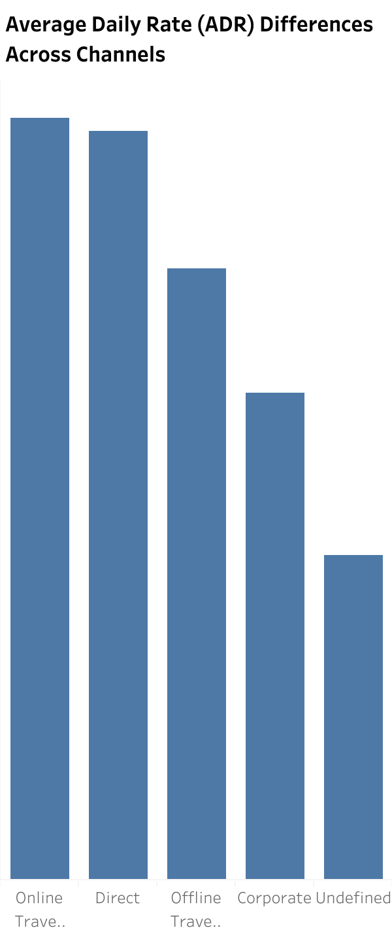
Methodology:
Created a bar chart to compare the average daily rate (ADR) across different distribution channels. Calculated the average daily rate for each booking made through different distribution channels. Insights for Average Daily Rate (ADR) Differences Across Channels:
Online travel agents generate the highest ADR at $108.57, while corporate bookings have the lowest at $69.33.
Actionable Recommendations:
To maximize revenue, focus on promoting channels with higher ADR, such as online travel agents. Tailor pricing strategies to each channel's ADR characteristics, ensuring competitiveness and profitability across all booking channels.

Slide 7
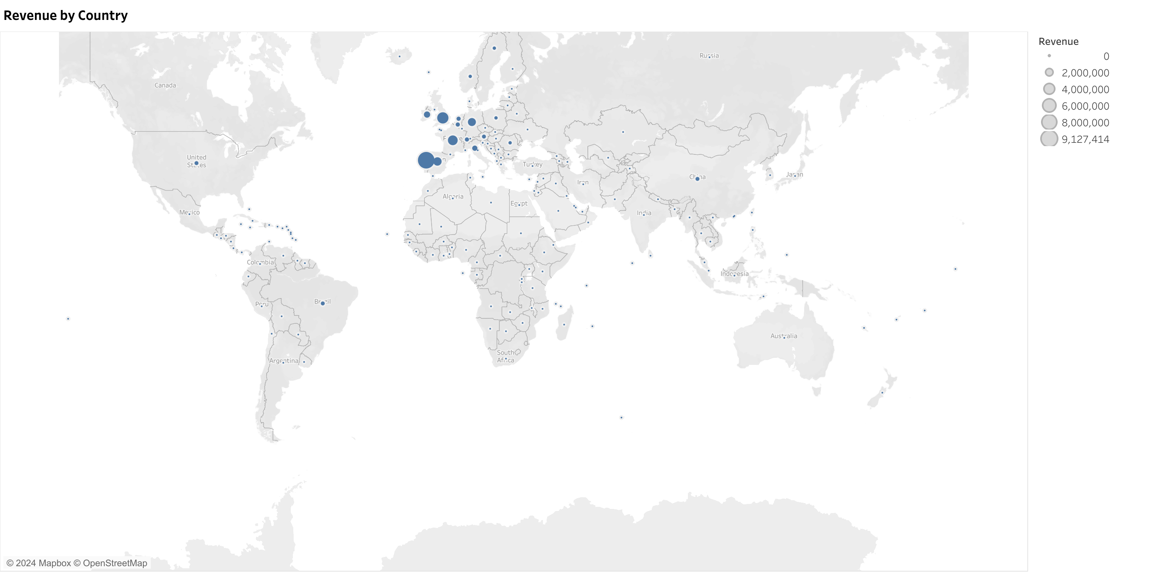
Methodology:
Created a bar chart to identify the top-contributing countries to total revenue. Summed the revenue generated by each country. Insights for Revenue Contribution by Country:
Poland emerges as the top revenue-generating country with $9,126,850, followed by the United Kingdom with $4.152,064 and France with $3.100,696.
Actionable Recommendations:
To maximize returns, focus marketing efforts on high-revenue countries like Poland, the United Kingdom, and France. Strengthen relationships with customers from these top-contributing countries by offering personalized services and tailored promotional offers. Additionally, explore opportunities to expand operations and establish a stronger presence in high-revenue regions to further capitalize on their revenue potential.

Slide 8
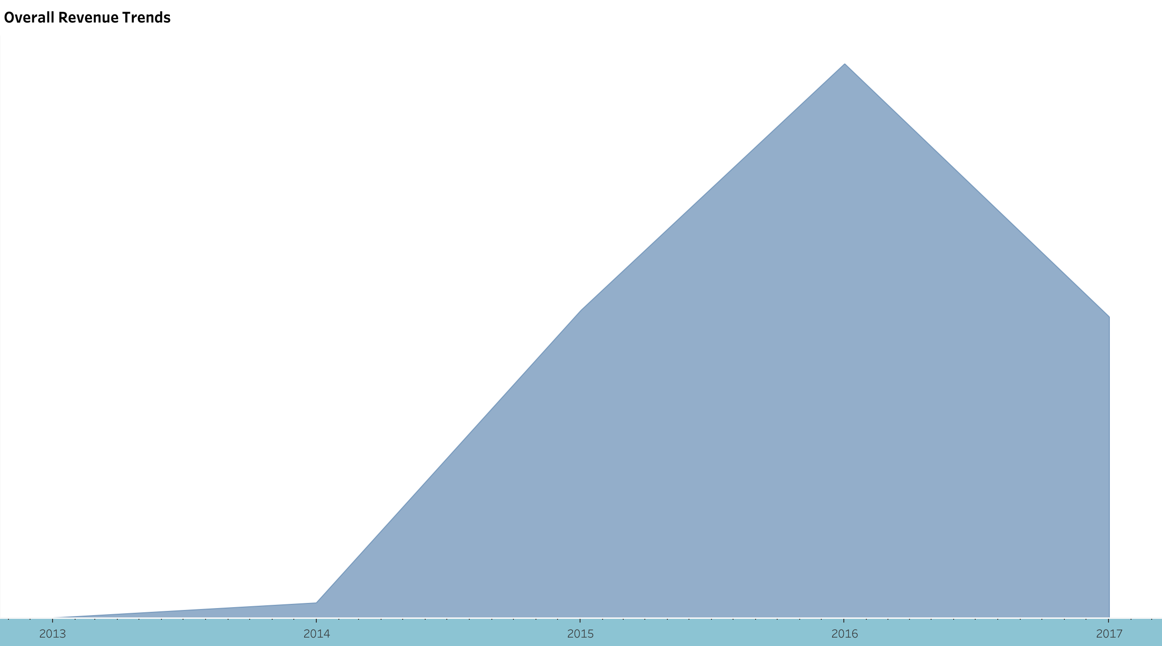
Methodology:
Created a line chart to visualize overall revenue trends over time. Aggregated the total revenue for each booking date. Insights for Revenue Growth Over Time:
Revenue started from $0 in 2013 and experienced significant growth, reaching $387,451 in 2014. It peaked in 2016 at $13,922,674 before declining to $7,563,293 in 2017.
Actionable Recommendations:
Utilize revenue trends to forecast future financial goals and set realistic targets for revenue growth. Implement seasonal promotions to boost revenue during low periods and maximize profitability. Explore opportunities to diversify revenue streams to reduce dependency on peak periods and ensure consistent income throughout the year.

Slide 9
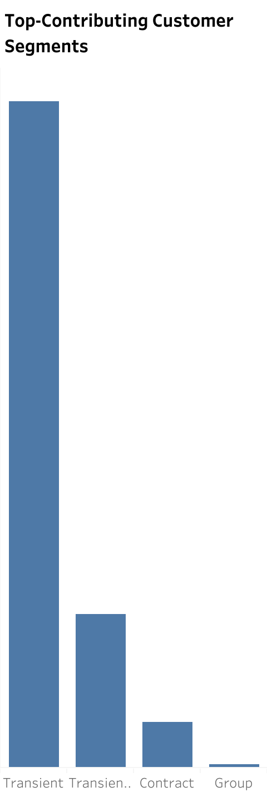
Methodology: Created a bar chart to identify the top-contributing customer segment to total revenue. Summed the revenue generated by each customer type or country. segments or countries
Insights for Revenue Contribution by Customer Segment:
Transient customers contribute the highest revenue, totaling $22,696,250.
Actionable Recommendations:
To maximize returns, focus marketing efforts on transient customers. Strengthen relationships with this segment by offering personalized services and tailored offers. Explore opportunities to expand into regions where transient customers are prevalent to capitalize on their revenue potential.

Slide 10
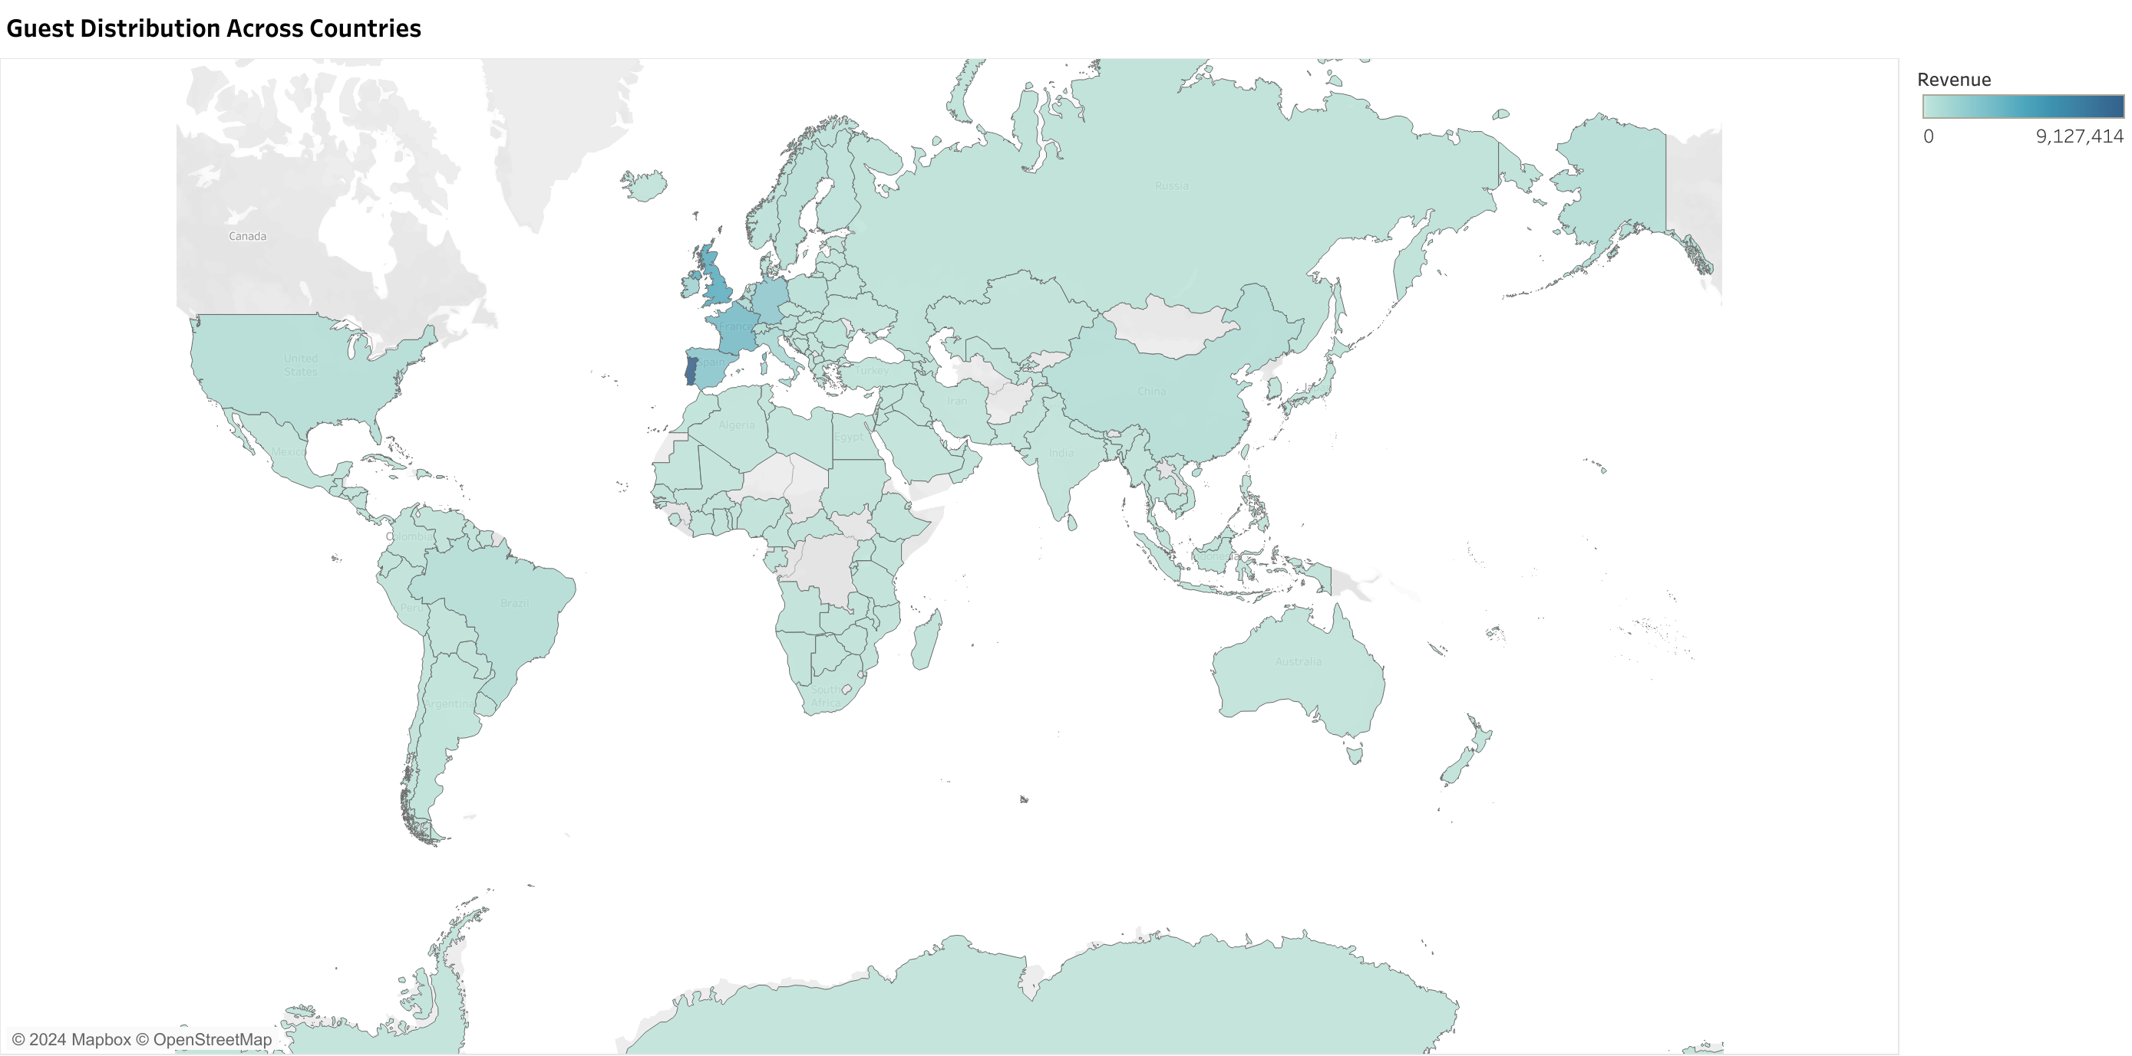
Methodology: Created a Map to identify the guest distribution across the country Insights for Guest Distribution Across Countries:
Portugal has the highest number of guests, with 49,078 guests, followed by the United Kingdom with 12,129 guests and France with 10,415 guests.
Actionable Recommendations:
Targeted Marketing: Focus marketing efforts on Portugal, the United Kingdom, and France to attract more guests from these high-volume countries. Explore partnership opportunities with local businesses or tourism agencies in Portugal, the United Kingdom, and France to enhance guest attraction and retention. Customize guest experiences and services to cater to the preferences and cultural backgrounds of guests from these countries, enhancing overall satisfaction and loyalty.

Slide 11
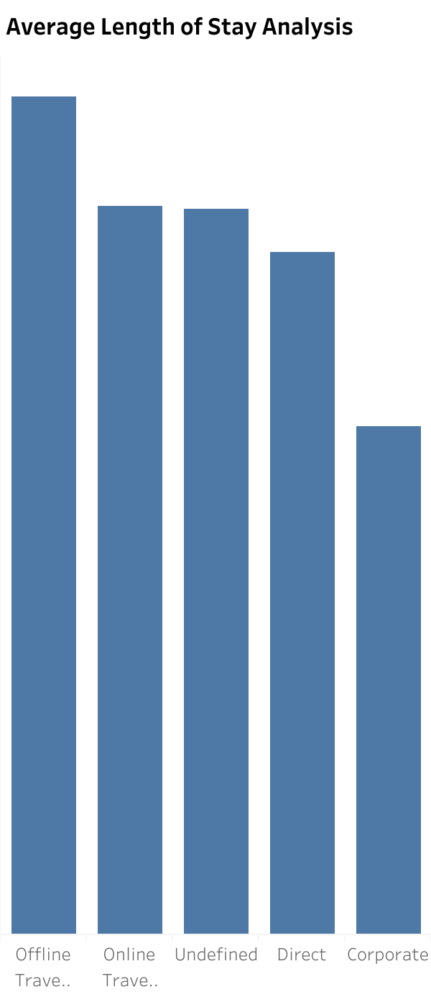
Methodology: Created a bar chart or histogram to analyze the average length of stay for different customer types or distribution channels. Calculated the average number of nights for each booking. Insights: Offline travel agents have the longest average length of stay, with customers spending an average of 3.922 nights. In contrast, corporate bookings have the shortest average length of stay at 2.381 nights.
Actionable Recommendations:
To encourage longer stays, create package offers tailored to segments with shorter average stays, such as corporate bookings. Optimize staffing and resource allocation based on stay patterns to improve operational efficiency, ensuring adequate support during peak periods. Enhance the guest experience for longer stays by offering special services and amenities that cater to their needs and preferences.

Slide 12
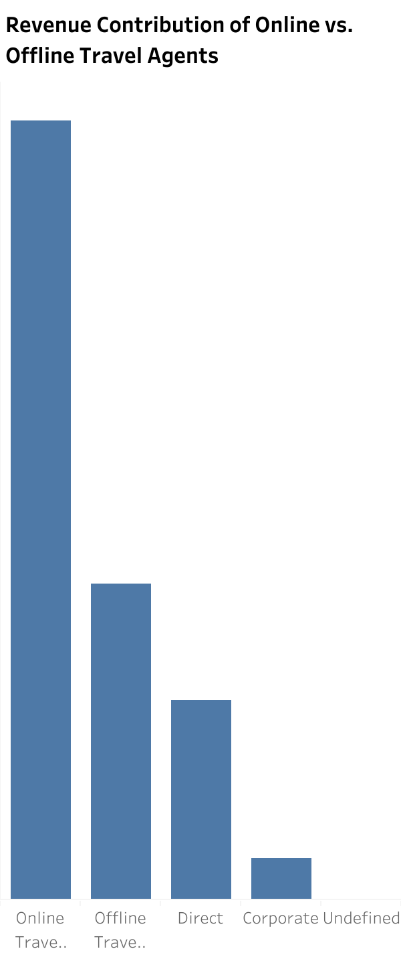
Methodology:
Created a bar chart to compare the revenue contribution of online and offline travel agents. Insights for Revenue Contribution of Online vs. Offline Travel Agents:
Online travel agents contribute the most to revenue, with $17,255,24, while offline travel agents contribute $6,993,596.
Actionable Recommendations:
Allocate resources and marketing efforts based on revenue contribution, focusing on channels that generate the most revenue. Strengthen partnerships with online travel agents to further capitalize on their revenue potential. Implement targeted offline promotions to boost revenue from offline travel agents and attract more bookings through this channel.

Slide 13
Insights Booking patterns fluctuate throughout the year, with January showing peak activity and June recording the lowest. Lead times vary across channels, with offline travel agents having the longest lead time and corporate bookings the shortest. Online travel agents generate the highest ADR, while corporate bookings have the lowest. Revenue growth peaked in 2016 but declined in subsequent years. Transient customers contribute the most revenue, while offline travel agents drive the least. Portugal, the United Kingdom, and France are the top countries in guest distribution. Recommendations
Target marketing efforts toward off-peak months to boost bookings. Tailor strategies based on lead time variations across booking channels. Implement dynamic pricing strategies to optimize revenue. Set realistic financial goals based on revenue trends. Focus marketing on high-revenue customer segments and countries. Strengthen partnerships with high-performing channels. Enhance guest experiences to encourage longer stays. Explore opportunities to expand into high-revenue regions. Conclusion
By leveraging insights into booking patterns, lead times, revenue trends, customer segments, and guest distribution, SHG can optimize its operations, enhance guest experiences, and maximize revenue generation. Through targeted marketing, strategic partnerships, and tailored services, SHG can establish a competitive edge in the hospitality industry and achieve sustainable growth.

Slide 14

THANK YOU

